Slide 1
Raft: An Understandable Consensus Algorithm
(In Search of an Understandable Consensus Algorithm)
林祥瑞

Slide 2
Introduction - Consensus Problem
What is distributed consensus problem?
Distributed consensus is a fundamental problem in fault-tolerant distributed systems. It involves multiple servers agreeing on values. Once they reach a decision on a value, that decision is final.
Relation to Byzantine Generals' Problem
Byzantine Generals' Problem is more general. Most servers are loyal, while some traitors can send fake or forged messages. BGP is not solvable. In the context of distributed consensus problem, servers are always loyal.

Slide 3
Introduction - Consensus Problem (cont.)
How the failures can be?
  Server crash
  Unreliable network
  Failures are not predictable
Other pratical solutions to consensus problem?
  Bitcoin or blockchain systems
  Paxos, a protocol published in 1989
  HDFS, used by Hadoop
fail
No matter some servers can fail, or connections can be broken, alive servers keep identical replicas to meet consensus.

Slide 4
Modeling the Consensus Problem
Practical Consensus algorithms have the following properties:
Safety: never returning an incorrect result under network delays, partitions, packet loss, duplication, and reordering.
Availability: Less than majority number of server crashes should not fail the whole system.
Not depend on timing to ensure the consistency of logs.
A command completes as soon as a majority of the cluster has responded to a single round of RPCs (remote procedure calls).
majority := more than half of servers

Slide 5
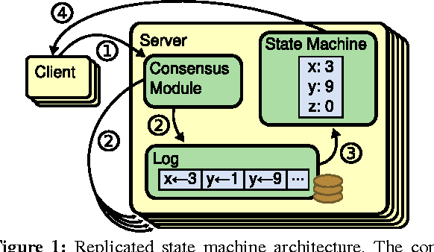
Modeling the Consensus Problem (cont.)
An approach is to model the servers as replicated state machines.
Servers have identical state machines.
Client commands are appended to logs as entries.
Logs is an indexed array.
The consensus module guarantees commands applied to state machines are always the same among servers.

Slide 6
Raft Basics - Intro
The team presents a great, easily understandable crash course on Raft algorithm.
Check out The Secret Lives of Data. Sweet.

Slide 7
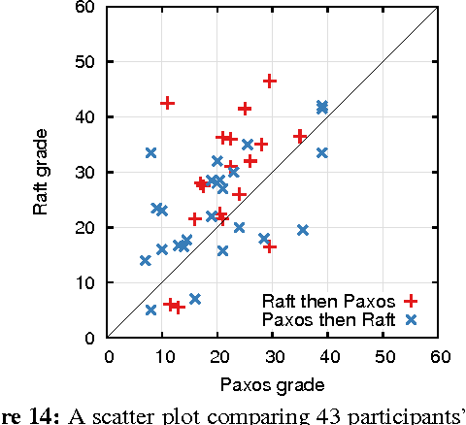
Raft Basics - Features
Designed with understandability and practicalness in mind.
In contrast to Paxos algorithm, it usually takes one year to fully comprehend Paxos.
The team even conducted a survey on this.

Slide 8
Raft Basics - Features (cont.)
Raft algorithm has the following features.
Strong leader
Leader election
Log replication
Safety

Slide 9
Raft Basics - Strong Leader
Always only one leader, others are followers.
Followers are passive, only leaders initial RPCs.
Followers redirect clients to leader.
client
command
leader
redirect
follower
follower
command
client

Slide 10
Raft Basics - Leader Election
A new leader must be chosen when an existing leader fails.
Election is done by randomization for simplicity.
dead
leader
candidate
vote
follower
vote
follower

Slide 11
Raft Basics - Log Replication
Only leader accepts log entries from clients.
Leader replicates them across the cluster, forcing the other logs to agree with its own.
In other words, followers’ logs can be overwritten by leader.
client
command
leader
replicate
replicate
follower
follower

Slide 12
Raft Basics - Safety
Safety means if any server has applied a particular log entry to its state machine, then no other server may apply a different command for the same log index.
To ensure safety, Raft guarantees these properties. (explained later)
Election Safety
Leader Append-only
Log Matching
Leader Completeness
State Machine Safety

Slide 13
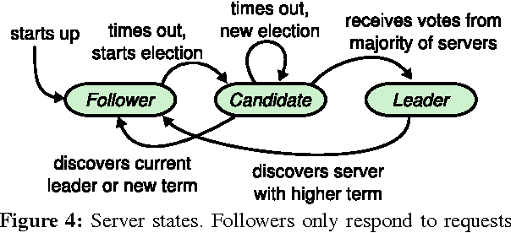
Raft Basics - Server States and RPCs
Server can be either one of
Follower: A passive state that only receives RPCs from one leader.
Candidate: The state requesting majority votes to become a leader.
Leader: Operate everything until failure.
Three RPCs available.
AppendEntries
RequestVote
InstallSnapshot

Slide 14
Raft Basics - Terms and Elections
Time is divided into terms.
Each server keeps a monotonic currentTerm value. It is increased by one when the server transfers to Candidate state, or be updated when servers sees higher terms thru RPCs.
Each term is initialed by an election, and produces at most one leader.
The leader is elected by majority vote, Each server votes at most once in one term.
currentTerm may differ among servers, in case of split votes.
用中文講就是每個伺服會記得現在是第幾屆選舉，每一屆最多投一票，得票過半者當選。

Slide 15
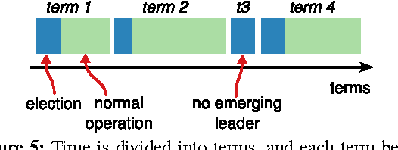
Raft Basics - Terms and Elections

Slide 16
Raft Basics - An Election Example
The 3rd term leader crashes.
One follower triggers election timeout, and becomes a candidate.
The candidate increase currentTerm by one to be 4.
The candidate sends RequestVote RPCs to others, wins majority vote, and becomes the 4th term leader. Others update currentTerm to 4.
dead
leader
dead
leader
dead
leader
candidate
4
vote
follower
4
follower
3
candidate
4
RequestVote
follower
3
follower
3
vote
RequestVote
follower
3
follower
3
follower
4

Slide 17
Raft Basics - Logs
Each server holds an indexed array of logs, commitIndex, and lastApplied, and lastApplied ≤ commitIndex.
Entries before lastApplied are already applied to its own state machine.
Entries before commitIndex is guaranteed to be present on major number of servers, and is considered safe.

Slide 18
Raft Basics - Logs
Entries are appended only when
  Leader recerves client’s command
  Leader replicates entries to others
An entry is committed when
  leader finishes replicating it on major number of servers.
Entries is appended at first, then
  be committed and finally be applied.
  be erased by leader’s AppendEntry RPC, in case of split vote.

Slide 19
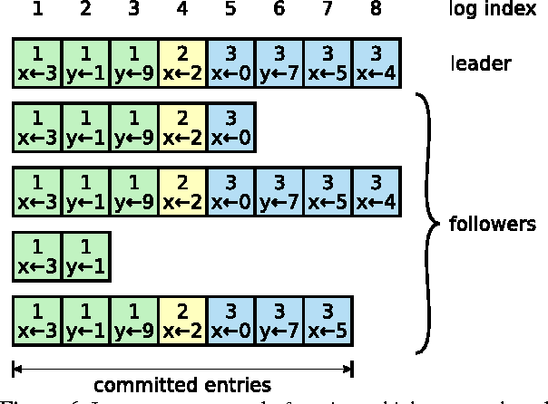
Raft Basics - Logs Example

Slide 20
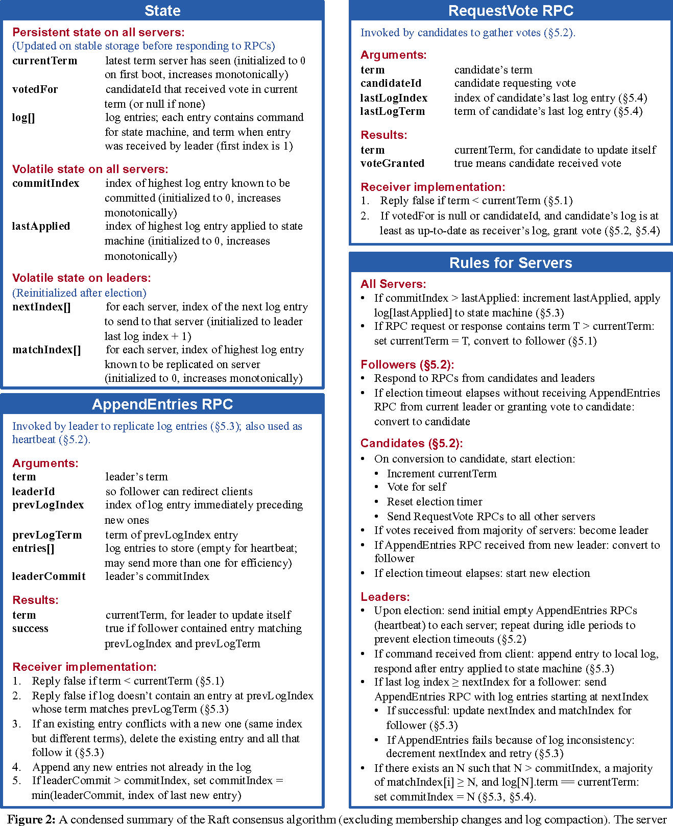
Server States
currentTerm: 現在是第幾屆選舉
votedFor: 當屆我投給誰
log[]: 我收上的命令陣列
commitIndex: 前n筆命令已經被提交（安全範圍）
lastApplied: 前n筆已送入自動機
nextIndex[]: 即將用AppendEntries寫入其他伺服的的位置
matchIndex[]: 和其他伺服匹配的資料比數

Slide 21
AppendEntries RPC
AppendEntries is only initiated by leader.
Purposes
  heatbeat: keeps followers from election timeout.
  replicate entries
  commit entries
  (implicitly) check term number

Slide 22
RequestVote RPC
RequestVote is only initiated by candidates.
Others grant vote if
  Candidate has the same or newer term.
  Candidate’s log is at least up-to-date with receiver’s.
  (implictly) check term number.

Slide 23
Rules
歸類成幾個原則
term 最大人的老大。
老大陣亡就會自辦選舉，無人當選則不斷重辦選舉。

Slide 24
Rules (cont.)
老大的責任
透過 heatbeat 不讓 follower 發起選舉。
對於第 k 位 follower，nextIndex[k] 由最大逐一遞減不斷嘗試送 AppendEntries ，直到 follower 接受爲止。

Slide 25
Safety Proof - Sketch
The overall safety is achieved by the properties.
Election Safety
Leader Append-only
Log Matching
Leader Completeness
State Machine Safety

Slide 26
Safety Proof - Election Safety
Election Safety means there’s at most one leader can be elected in a given term.
It is guaranteed by
majority vote
each server votes at most once in one term.

Slide 27
Safety Proof - Leader Append-Only
Leader Append-Only means a leader never overwrites or deletes entries in its log; it only appends new entries.
Only clients can append new entries on leader, and leader replicates them to followers.
Entries can disappear ONLY WHEN the leader overwrites others’ logs.

Slide 28
Safety Proof - Log Matching
Log Matching means if two logs contain an entry with the same index and term, then the logs are identical in all entries up through the given index.
Proven by induction.
Initial empty logs satisfies the Log Matching Property.
Consistency checks preserves the Log Matching Property whenever logs are extended.
Successful AppendEntries returns satisfies Log Matching Property.

Slide 29
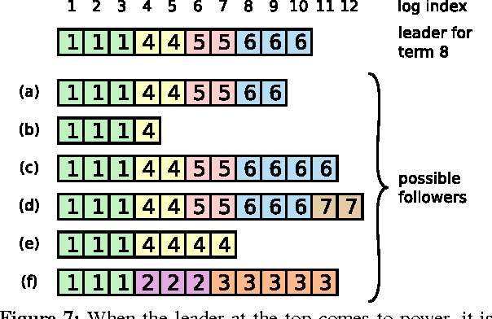
Safety Proof - Log Matching (cont.)
Logs inconsistency occurs when the leader crashes, but it does not violate Log Matching Property.

Slide 30
Safety Proof - Leader Completeness
Leader Completeness means if a log entry is committed in a given term, then that entry will be present in the logs of the leaders for all higher-numbered terms.
Leader Completeness is achieved by election restriction. Winning of election implies
A candidate must contact a majority of the server.
Every committed entry must be present in at least one of those servers.
Candidate’s log is at least as up-to-date as any other log in that majority.

Slide 31
Safety Proof - Leader Completeness (cont.)
The server receiving RequestVote checks if candidate’s logs is up-to-date.
If the logs have last entries with different terms, then the log with the later term is more up-to-date.
If the logs end with the same term, then whichever log is longer is more up-to-date.
The vote is granted if candidate’s logs is at least up-to-date with receiver’s.

Slide 32
Safety Proof - Leader Completeness (cont.)
By Pigeonhole principle, at least one granted voter has committed entries.
the server that votes
the server having committed entries

Slide 33
Safety Proof - Leader Completeness (cont.)
A more rigorous proof is done by contradiction.
We assume Leader Completeness Property does not hold.
Suppose the leader for term T (leader_{T}) commits a log entry from its term, but that log entry is not stored by the leader of some future term.
Consider the smallest term U > T whose leader (leader_{U}) does not store the entry.

Slide 34
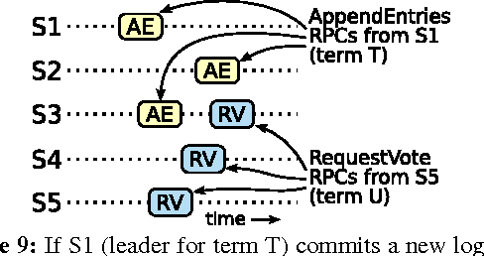
Safety Proof - Leader Completeness (cont.)
The committed entry must have been absent from leader_{U}’s log at the time of its election (Leader Append-Only).
leader_{T} replicated the entry on a majority of the cluster, and leader_{U} received votes from a majority of the cluster. Thus, at least one server (“the voter”) both accepted the entry from leader_{T} and voted for leader_{U}. (Pigeonhole principle)

Slide 35
Safety Proof - Leader Completeness (cont.)
The voter must have accepted the committed entry from leader_{T} before voting for leader_{U}; otherwise it would have rejected the AppendEntries request from leader_{T} (its current term would have been higher than T).
The voter still stored the entry when it voted for leader_{U}, since every intervening leader contained the entry (by assumption), leaders never remove entries, and followers only remove entries if they conflict with the leader.

Slide 36
Safety Proof - Leader Completeness (cont.)
“The voter” granted its vote to leader_{U}, so leader_{U}’s log must have been as up-to-date as the voter’s. This leads to one of two contradictions.
(Case 1) If the voter and leader_{U} shared the same last log term, then leader_{U}’s log must have been at least as long as the voter’s, so its log contained every entry in the voter’s log. This is a contradiction, since the voter contained the committed entry and leader_{U} was assumed not to.

Slide 37
Safety Proof - Leader Completeness (cont.)
(Case 2) leader_{U}’s last log term must have been larger than the voter’s. Moreover, it was larger than T, since the voter’s last log term was at least T (it contains the committed entry from term T). The earlier leader that created leader_{U}’s last log entry must have contained the committed entry in its log (by assumption). Then, by the Log Matching Property, leader U ’s log must also contain the committed entry, which is a contradiction.
This completes the contradiction. Thus, the leaders of all terms greater than T must contain all entries from term T that are committed in term T.
The Log Matching Property guarantees that future leaders will also contain entries that are committed indirectly.

Slide 38
Safety Proof - State Machine Safety
State Machine Safety means if a server has applied a log entry at a given index to its state machine, no other server will ever apply a different log entry for the same index.
Server only applies committed entries to state machine.
By Leader Completeness Property and Log Completeness Property, the State Machine Safety holds.

Slide 39
Committing entries from previous terms
A leader knows that an entry from its current term is committed once that entry is stored on a majority of the servers.
However, a leader cannot immediately conclude that an entry from a previous term is committed once it is stored on a majority of servers

Slide 40
Committing entries from previous terms (cont.)
Committing entries from previous terms would be a trouble. Raft takes a conservative approach.
Raft never commits log entries from previous terms by counting replicas. Only log entries from the leader’s current term are committed by counting replicas.
Once an entry from the current term has been committed in this way, then all prior entries are committed indirectly because of the Log Matching Property.

Slide 41
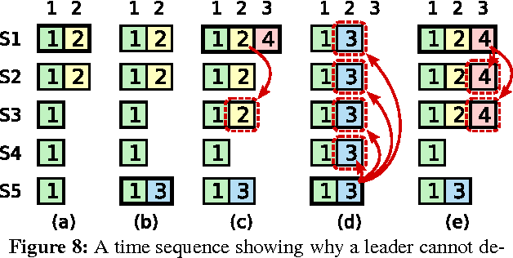
Committing entries from previous terms (cont.)
S1 is the leader of term 2.
S1 crashes. S5 is elected as the leader of term 3.
S5 crashed. S1 restarts and is elected as the leader of term 4. It replicates an entry to major number of servers, but it’s not committed.
If S1 crashes and S5 become the leader again, major number of entries is overwritten.
If S1 does not crash, logs on S1 will be finally committed.

Slide 42
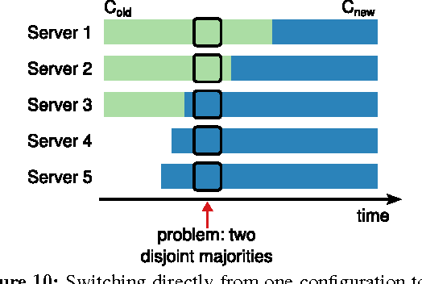
Cluster membership changes
Server switches configuration to change membership.
Switching directly is unsafe, and possibly causes two different leaders can be elected for the same term.

Slide 43
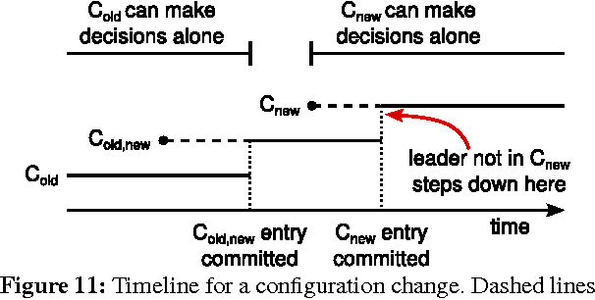
Cluster membership changes (cont.)
To resolve this, the cluster first switches to a transitional configuration called joint consensus.
Configurations is treated as an entry in logs. A joint consensus config C_{old,new} is issued first, then the new config C_{new} is issued.

Slide 44
Timing and Availability
Leader election is the aspect of Raft where timing is most critical. Raft will be able to elect and maintain a steady leader as long as the system satisfies the following timing requirement
broadcastTime ≪ electionTimeout ≪ MTBF
broadcastTime is the average time it takes a server to send RPCs in parallel to every server in the cluster and receive their responses.
MTBF is the average time between failures for a single server.
The election timeout is likely to be somewhere between 10ms and 500ms.

Slide 45
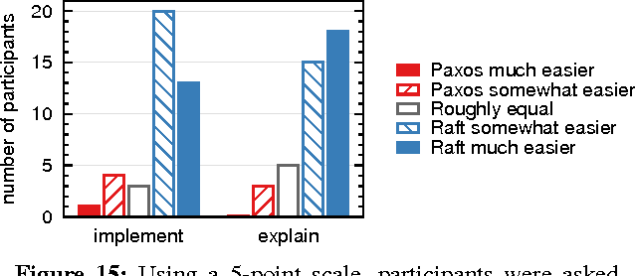
Experiments - Understandability
The team conducted an experimental study using upper-level undergraduate and graduate students in an in Stanford University and U.C. Berkeley.

Slide 46
Experiments - Correctness
The team developed a formal specification and a proof of safety for the consensus mechanism in TLA+ specification language.
TLA+ is used to design, model, document, and verify concurrent systems

Slide 47
Experiments - Performance
Raft achieves this using the minimal number of messages (a single round-trip from the leader to half the cluster) to replicating new log entries.
To measure leader election, they repeatedly crashed the leader of a cluster of five servers and timed how long it took to detect the crash and elect a new leader.

Slide 48
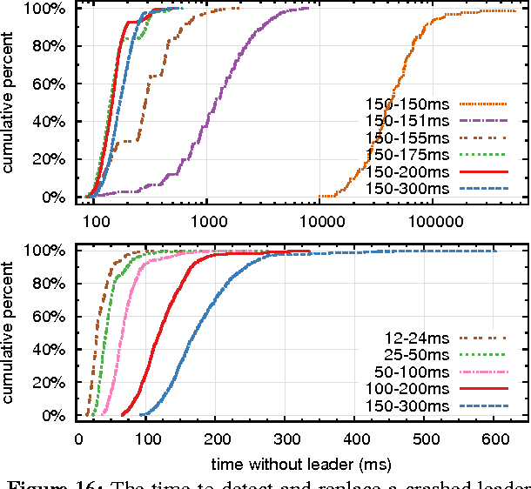
Experiments - Performance (cont.)
1000 trails
The leader was crashed uniformly randomly within its heartbeat interval, which was half of the minimum election timeout for all tests.

